Slide 1
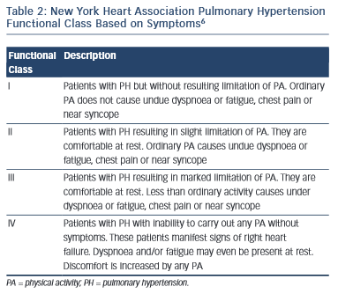
Madden BP
Table 2: New York Heart Association Pulmonary Hypertension Functional Class Based on Symptoms
Citation: European Cardiology Review 2015;10(2):102–7
https://doi.org/10.15420/ecr.2015.10.2.102

