Slide 1
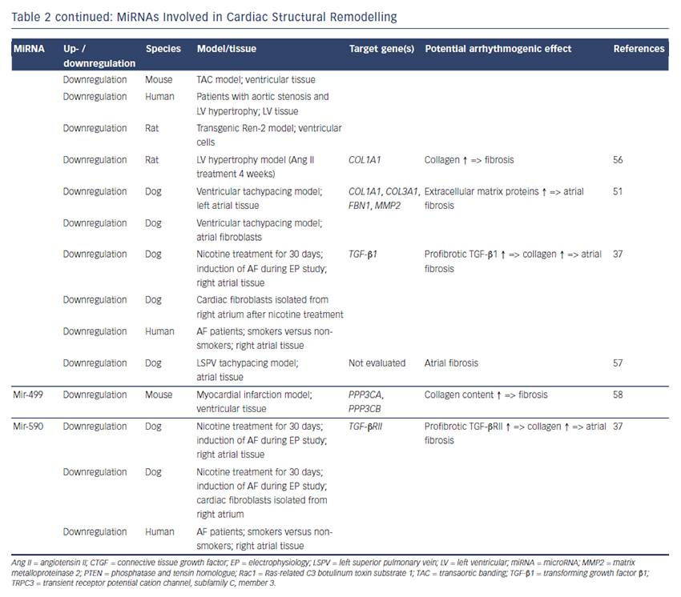
Clauss S, Sinner MF, Kääb S, Wakili R
Table 2 continued: MiRNAs Involved in Cardiac Structural Remodelling
Citation: Arrhythmia & Electrophysiology Review 2015;4(3):146–55
https://doi.org/10.15420/aer.2015.4.3.146

