Slide 1
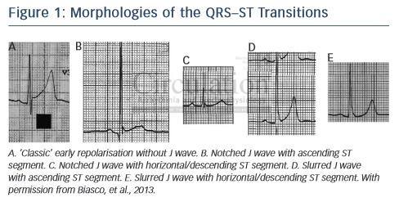
Katritsis DG, Gersh BJ, Camm AJ
Figure 1: Morphologies of the QRS–ST Transitions
Citation: Arrhythmia & Electrophysiology Review 2015;4(3):169–71
https://doi.org/10.15420/aer.2015.4.3.169

