Slide 1
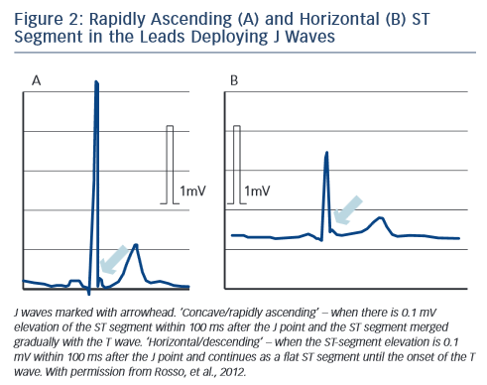
Katritsis DG, Gersh BJ, Camm AJ
Figure 2: Rapidly Ascending (A) and Horizontal (B) ST&lt;br /&gt;&#10;Segment in the Leads Deploying J Waves
Citation: Arrhythmia & Electrophysiology Review 2015;4(3):169–71
https://doi.org/10.15420/aer.2015.4.3.169

