Slide 1
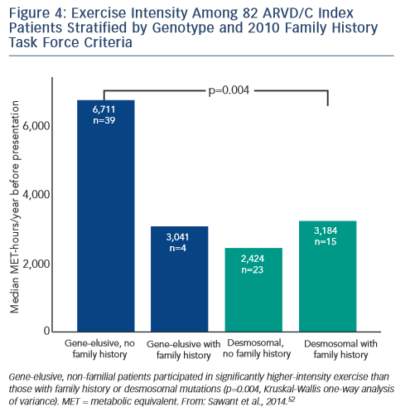
James CA
Model of the Relative Influence
Citation: Arrhythmia & Electrophysiology Review 2015;4(3):156–62
https://doi.org/10.15420/aer.2015.4.3.156

