Slide 1

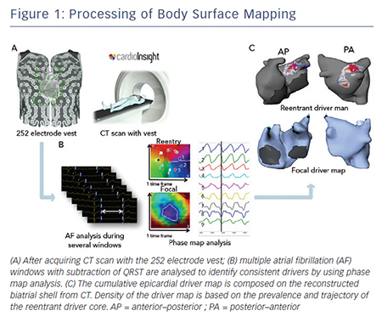
Yamashita S, Shah AJ, Mahida S, Sellal JM, Berte B, Hooks D, Frontera A, Al Jefairi N, Wielandts JY, Lim HS, Amraoui S, Denis A, Derval N, Sacher F, Cochet H, Hocini M, Jaïs P, Haissaguerre M
Figure 1: Processing of Body Surface Mapping
Citation: Arrhythmia & Electrophysiology Review 2015;4(3):172–6
https://doi.org/10.15420/aer.2015.4.3.172

