Slide 1
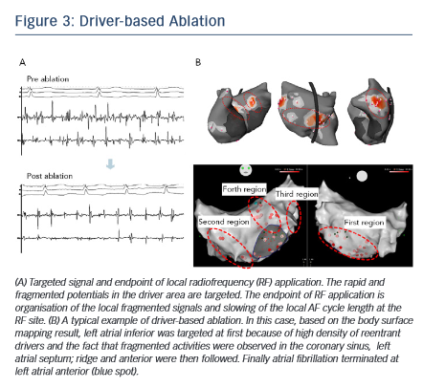
Yamashita S, Shah AJ, Mahida S, Sellal JM, Berte B, Hooks D, Frontera A, Al Jefairi N, Wielandts JY, Lim HS, Amraoui S, Denis A, Derval N, Sacher F, Cochet H, Hocini M, Jaïs P, Haissaguerre M
Figure 3: Driver-based Ablation
Citation: Arrhythmia & Electrophysiology Review 2015;4(3):172–6
https://doi.org/10.15420/aer.2015.4.3.172

