Slide 1
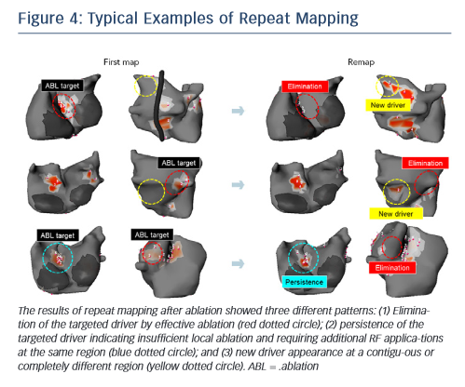
Yamashita S, Shah AJ, Mahida S, Sellal JM, Berte B, Hooks D, Frontera A, Al Jefairi N, Wielandts JY, Lim HS, Amraoui S, Denis A, Derval N, Sacher F, Cochet H, Hocini M, Jaïs P, Haissaguerre M
Figure 4: Typical Examples of Repeat Mapping
Citation: Arrhythmia & Electrophysiology Review 2015;4(3):172–6
https://doi.org/10.15420/aer.2015.4.3.172

