Slide 1
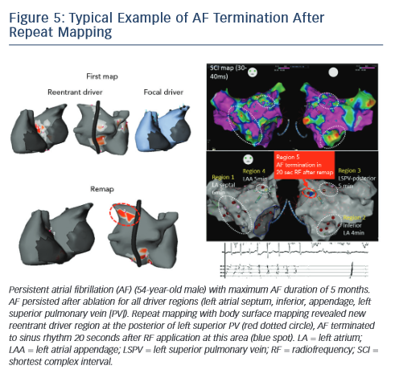
Yamashita S, Shah AJ, Mahida S, Sellal JM, Berte B, Hooks D, Frontera A, Al Jefairi N, Wielandts JY, Lim HS, Amraoui S, Denis A, Derval N, Sacher F, Cochet H, Hocini M, Jaïs P, Haissaguerre M
Figure 5: Typical Example of AF Termination After Repeat Mapping
Citation: Arrhythmia & Electrophysiology Review 2015;4(3):172–6
https://doi.org/10.15420/aer.2015.4.3.172

