Slide 1
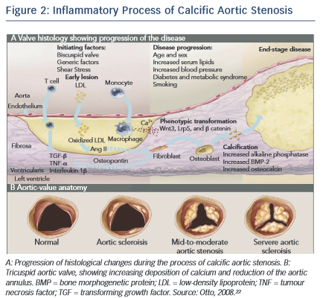
Lerman DA, Prasad S, Alotti N
Inflammatory Process of Calcific Aortic Stenosis
Citation: European Cardiology Review 2015;10(2):108–12
https://doi.org/10.15420/ecr.2015.10.2.108

