Slide 1
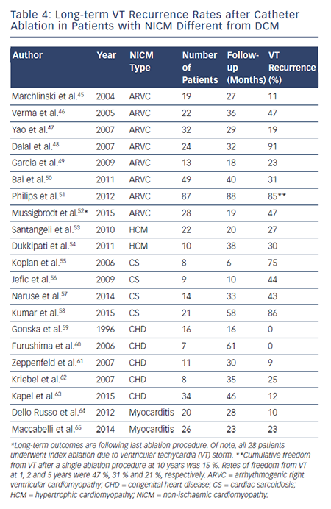
Liang JJ, Santangeli P, Callans DJ
Table 4: Long-term VT Recurrence Rates after Catheter Ablation in Patients with NICM Different from DCM
Citation: Arrhythmia & Electrophysiology Review 2015;4(3):177–83
https://doi.org/10.15420/aer.2015.4.3.177

