Slide 1
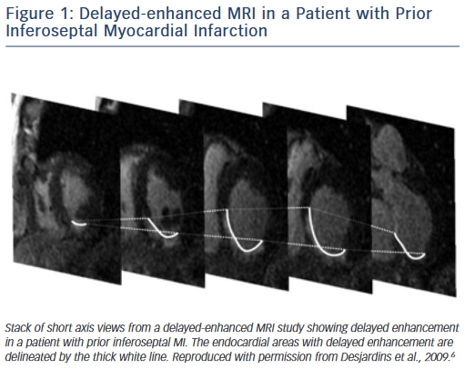
Njeim M, Bogun F
Figure 1: Delayed-enhanced MRI in a Patient
Citation: Arrhythmia & Electrophysiology Review 2015;4(3):184–8
https://doi.org/10.15420/aer.2015.4.3.184

