Slide 1
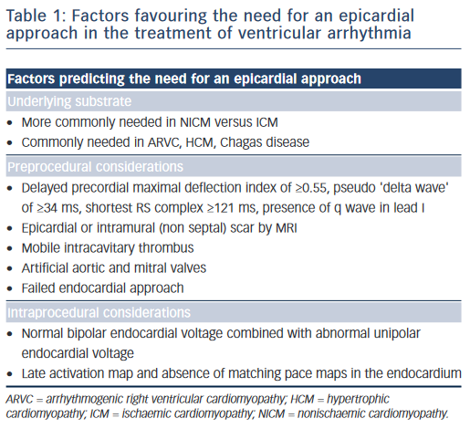
Njeim M, Bogun F
Table 1: Factors favouring the need for an epicardial approach in the treatment of ventricular arrhythmia
Citation: Arrhythmia & Electrophysiology Review 2015;4(3):184–8
https://doi.org/10.15420/aer.2015.4.3.184

