Slide 1
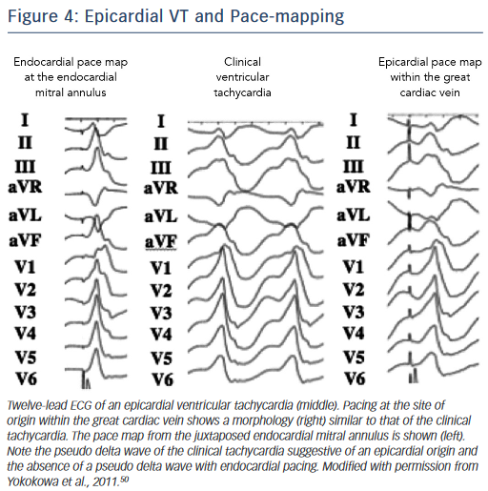
Njeim M, Bogun F
Figure 4: Epicardial VT and Pace-mapping
Citation: Arrhythmia & Electrophysiology Review 2015;4(3):184–8
https://doi.org/10.15420/aer.2015.4.3.184

