Slide 1
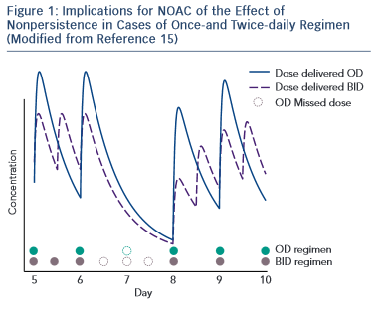
Dan GA, Buzea AC
Figure 1: Implications for NOAC of the Effect of&lt;br /&gt;&#10;Nonpersistence in Cases of Once-and Twice-daily Regimen
Citation: European Cardiology Review 2015;10(2):76–8
https://doi.org/10.15420/ecr.2015.10.2.76

