Slide 1
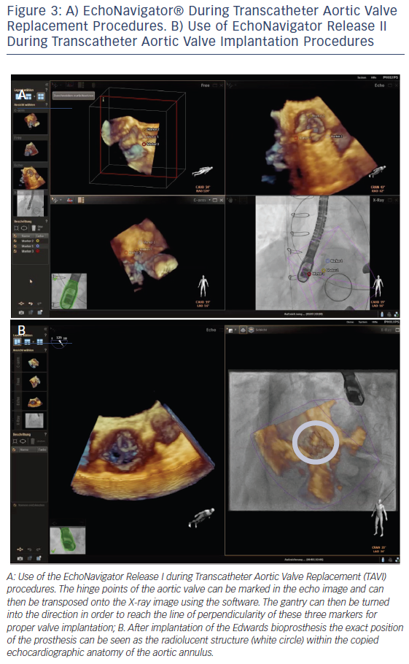
Balzer J, Zeus T, Veulemans V, Kelm M
A) EchoNavigator® During Transcatheter Aortic Valve Replacement Procedures. B) Use of EchoNavigator Release II During Transcatheter Aortic Valve Implantation Procedures
Citation: Interventional Cardiology Review 2016;11(1):59–64
https://doi.org/10.15420/icr.2016.11.1.59

