Slide 1
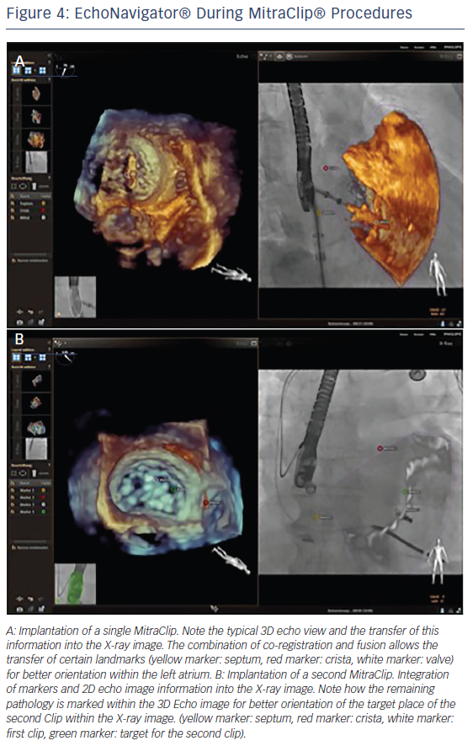
Balzer J, Zeus T, Veulemans V, Kelm M
EchoNavigator® During MitraClip® Procedures
Citation: Interventional Cardiology Review 2016;11(1):59–64
https://doi.org/10.15420/icr.2016.11.1.59

