Slide 1
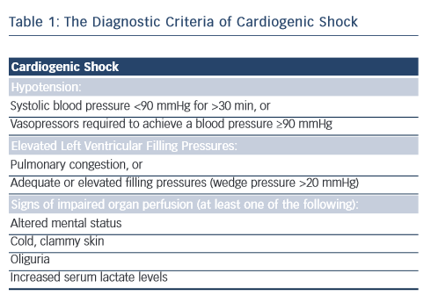
Joseph J, Patterson T, Arri S, McConkey H, Redwood S
Table 1: The Diagnostic Criteria of Cardiogenic Shock
Citation: Interventional Cardiology Review 2016;11(1):39–43
https://doi.org/10.15420/icr.2016.11.1.39

