Slide 1
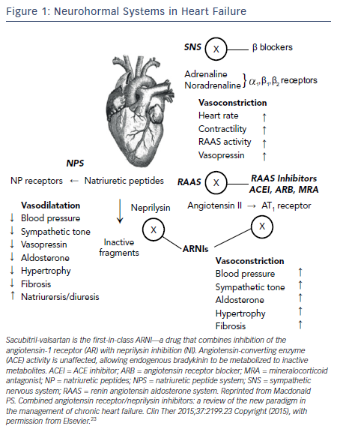
Kittleson M
Figure 1: Neurohormal Systems in Heart Failure
Citation: US Cardiology Review 2016;10(1):8–13
https://doi.org/10.15420/usc.2016.10.1.8

