Slide 1
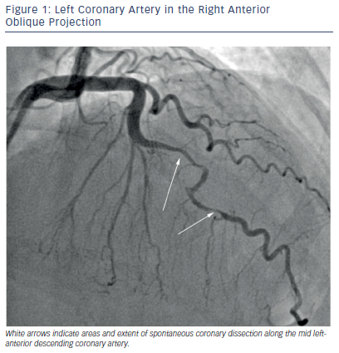
Martinez SC, Hayes SN
Figure 1: Left Coronary Artery in the Right Anterior Oblique Projection
Citation: US Cardiology Review 2016;10(1):14–20
https://doi.org/10.15420/usc.2016.10.1.14

