Slide 1
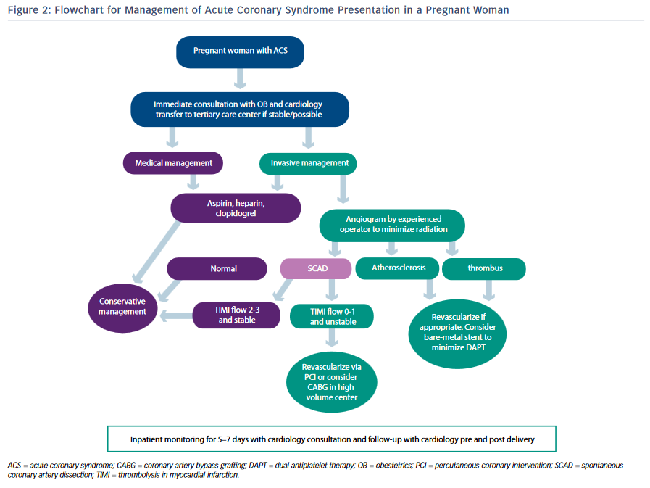
Martinez SC, Hayes SN
Figure 2: Flowchart for Management of Acute Coronary Syndrome Presentation in a Pregnant Woman
Citation: US Cardiology Review 2016;10(1):14–20
https://doi.org/10.15420/usc.2016.10.1.14

