Slide 1
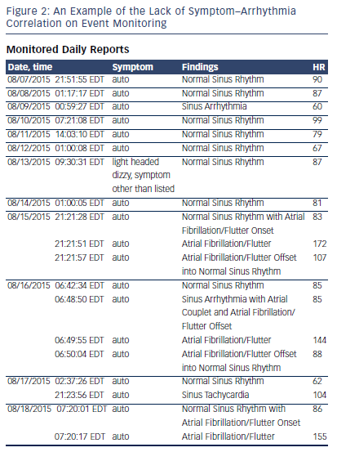
Parikh P, Venkatachalam K
Figure 2: An Example of the Lack of Symptom–Arrhythmia Correlation on Event Monitoring
Citation: US Cardiology Review 2016;10(1):26–9
https://doi.org/10.15420/usc.2016.10.1.26

