Slide 1
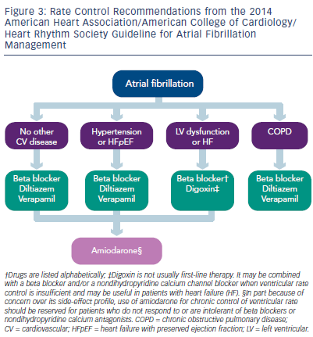
Parikh P, Venkatachalam K
Figure 3: Rate Control Recommendations from the 2014 American Heart Association/American College of Cardiology/ Heart Rhythm Society Guideline for Atrial Fibrillation Management
Citation: US Cardiology Review 2016;10(1):26–9
https://doi.org/10.15420/usc.2016.10.1.26

