Slide 1
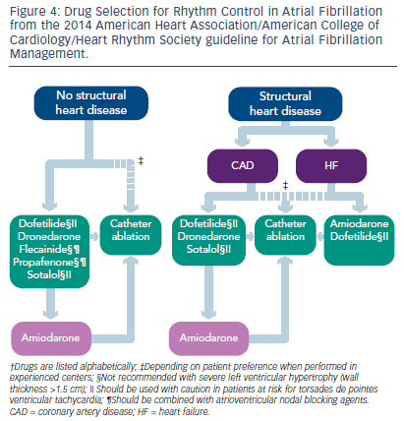
Parikh P, Venkatachalam K
Figure 4: Drug Selection for Rhythm Control in Atrial Fibrillation from the 2014 American Heart Association/American College of Cardiology/Heart Rhythm Society guideline for Atrial Fibrillation Management.
Citation: US Cardiology Review 2016;10(1):26–9
https://doi.org/10.15420/usc.2016.10.1.26

