Slide 1
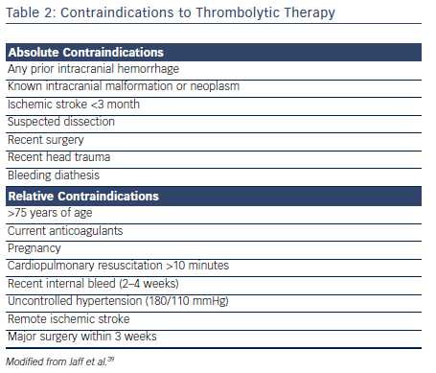
Malik S, Bhardwaj A, Eisen M, Gandhi S
Table 2: Contraindications to Thrombolytic Therapy. Thrombolysis Contraindications.
Citation: US Cardiology Review 2016;10(1):30–5
https://doi.org/10.15420/usc.2016.10.1.30

