Slide 1
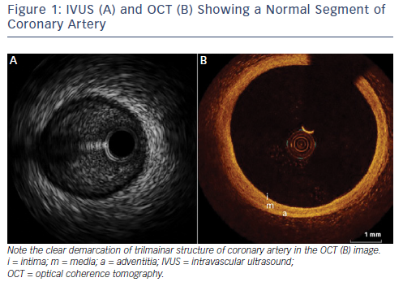
Koganti S, Kotecha T, Rakhit RD
Figure 1: IVUS (A) and OCT (B) Showing a Normal Segment of Coronary Artery
Citation: Interventional Cardiology Review, 2016;11(1):11–6
https://doi.org/10.15420/icr.2016:6:1

