Slide 1
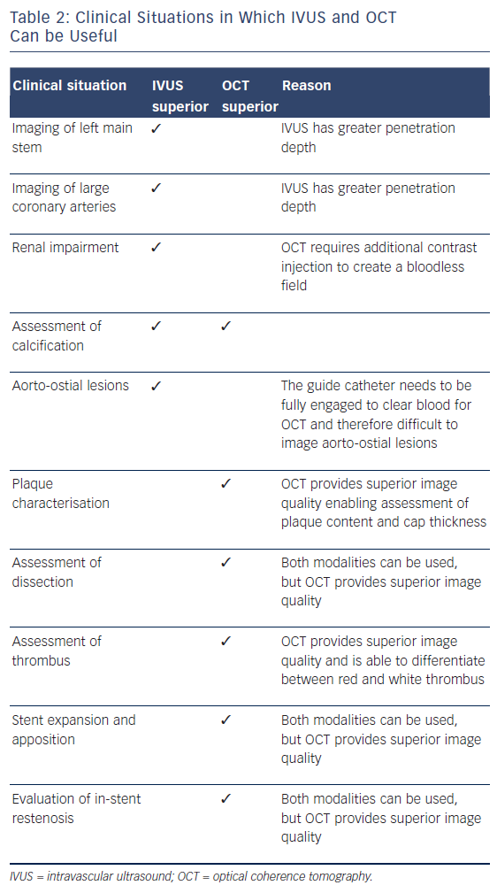
Koganti S, Kotecha T, Rakhit RD
Table 2: Clinical Situations in Which IVUS and OCT Can be Useful
Citation: Interventional Cardiology Review, 2016;11(1):11–6
https://doi.org/10.15420/icr.2016:6:1

