Slide 1
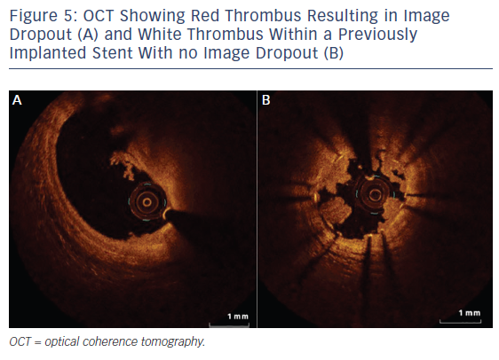
Koganti S, Kotecha T, Rakhit RD
Figure 5: OCT Showing Red Thrombus Resulting in Image Dropout (A) and White Thrombus Within a Previously Implanted Stent With no Image Dropout (B)
Citation: Interventional Cardiology Review, 2016;11(1):11–6
https://doi.org/10.15420/icr.2016:6:1

