Slide 1
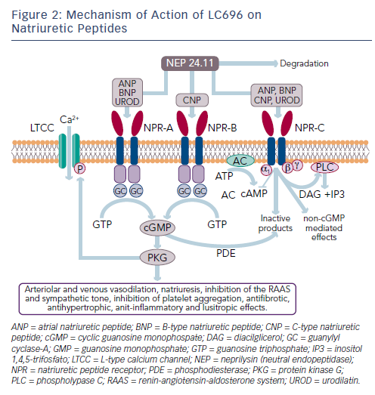
Tamargo J
Figure 2: Mechanism of Action of LC696 on Natriuretic Peptides
Citation: Cardiac Failure Review 2016;2(1):40–6
https://doi.org/10.15420/cfr.2016:1:1

