Slide 1
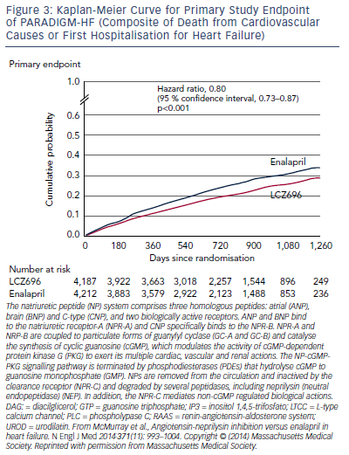
Tamargo J
Figure 3: Kaplan-Meier Curve for Primary Study Endpoint of PARADIGM-HF (Composite of Death from Cardiovascular Causes or First Hospitalisation for Heart Failure)
Citation: Cardiac Failure Review 2016;2(1):40–6
https://doi.org/10.15420/cfr.2016:1:1

