Slide 1

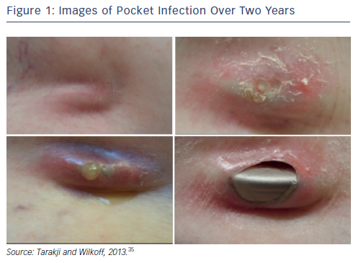
Tarakji KG, Ellis CR, Defaye P, Kennergren C
Figure 1: Images of Pocket Infection Over Two Years
Citation: Arrhythmia & Electrophysiology Review 2016;5(1):65–71
https://doi.org/10.15420/aer.2015.27.2

