Slide 1
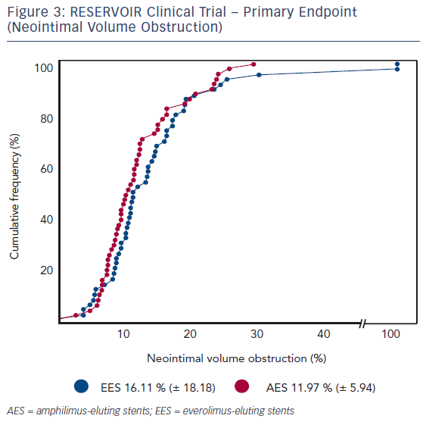
Carrie D
Figure 3: RESERVOIR Clinical Trial – Primary Endpoint (Neointimal Volume Obstruction)
Citation: Interventional Cardiology Review 2016;11(1):47–50
https://doi.org/10.15420/icr.2016.11.1.47

