Slide 1
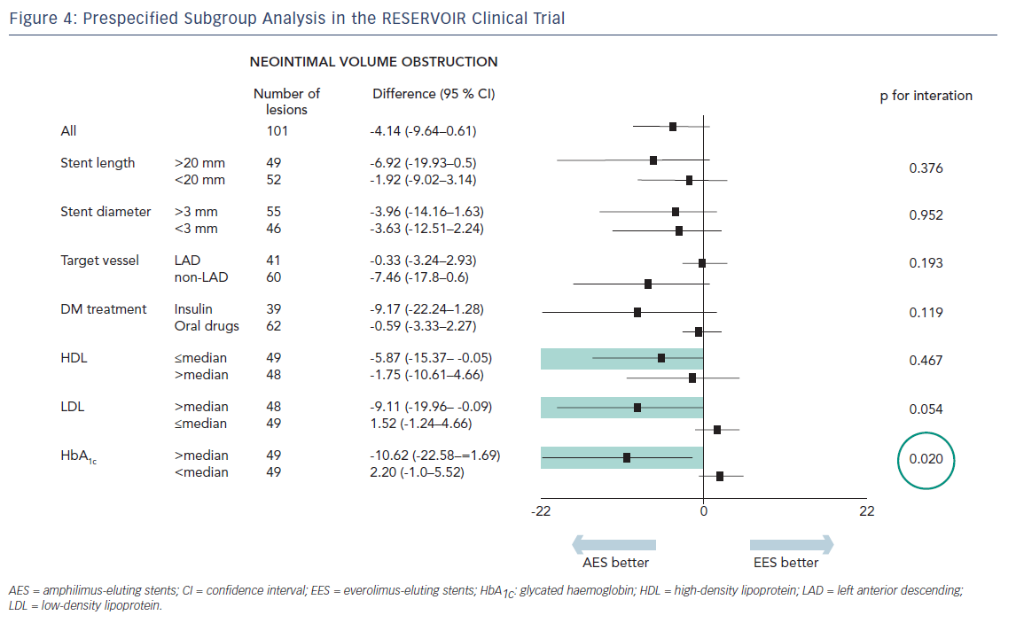
Carrie D
Figure 4: Prespecified Subgroup Analysis in the RESERVOIR Clinical Trial
Citation: Interventional Cardiology Review 2016;11(1):47–50
https://doi.org/10.15420/icr.2016.11.1.47

