Slide 1
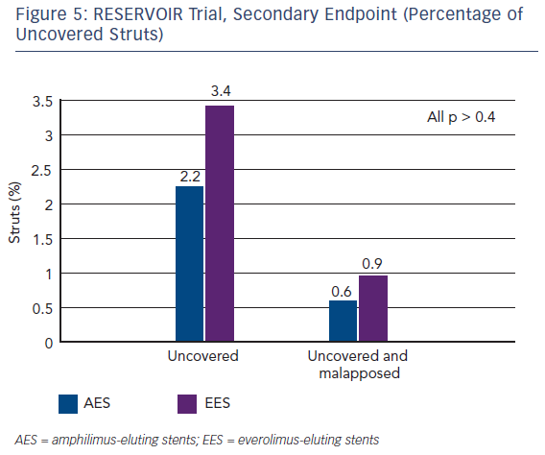
Carrie D
Figure 5: RESERVOIR Trial, Secondary Endpoint (Percentage of Uncovered Struts)
Citation: Interventional Cardiology Review 2016;11(1):47–50
https://doi.org/10.15420/icr.2016.11.1.47

