Slide 1
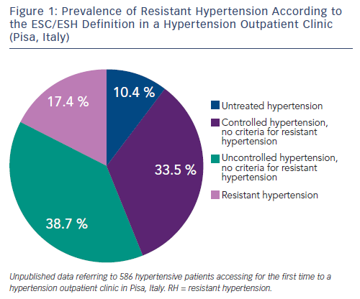
Taddei S, Bruno RM
Figure 1: Prevalence of Resistant Hypertension According to the ESC/ESH Definition in a Hypertension Outpatient Clinic (Pisa, Italy)
Citation: European Cardiology Review 2016;11(1):8–11
https://doi.org/10.15420/ecr.2016.11.1

