Slide 1
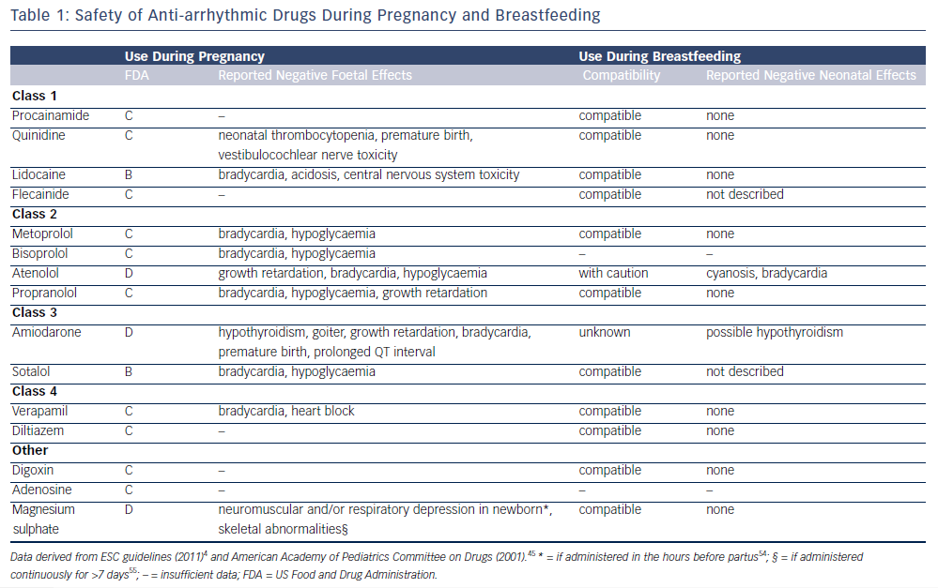
Yaksh A, van der Does LJ, Lanters EA, de Groot NM
Safety of Anti-arrhythmic Drugs During Pregnancy and Breastfeeding
Citation: Arrhythmia & Electrophysiology Review 2016;5(1):41–4
https://doi.org/10.15420/aer.2016.1.2

