Slide 1
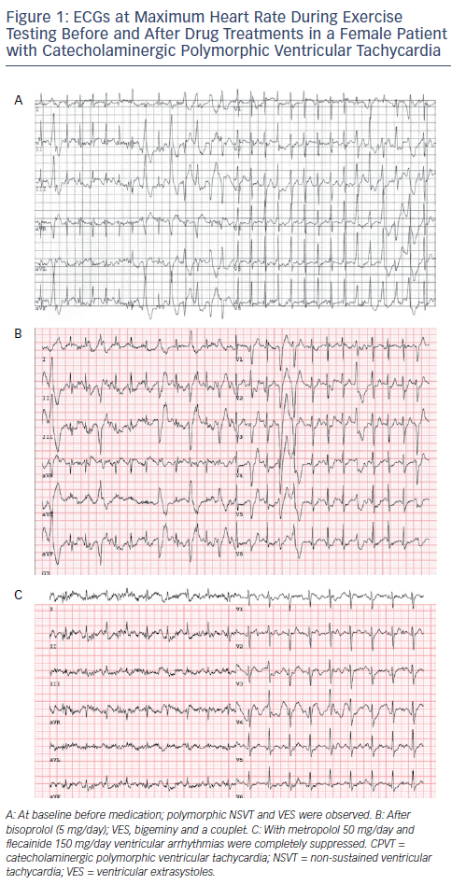
Lieve KV, Wilde AA, van der Werf C
Figure 1: ECGs at Maximum Heart Rate During Exercise Testing Before and After Drug Treatments in a Female Patient with Catecholaminergic Polymorphic Ventricular Tachycardia
Citation: Arrhythmia & Electrophysiology Review 2016;5(1):45–9
https://doi.org/10.15420/aer.2016.3.3

