Slide 1
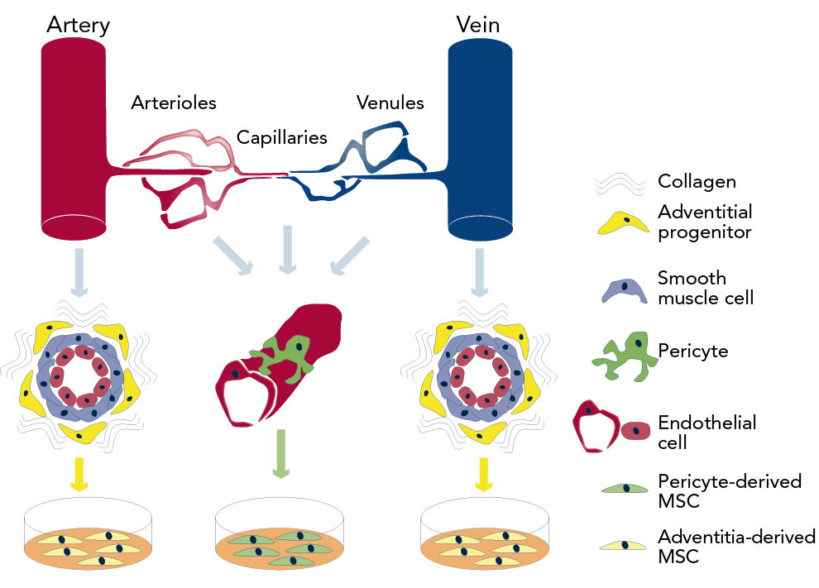
Lerman DA, Alotti N, Ume KL, Péault B
Origin of Potential Stem Cells. Modified from an Original Drawing by Mirko Corselli
Citation: European Cardiology Review 2016;11(1):43–8
https://doi.org/10.15420/ecr.2016:8:1

