Slide 1
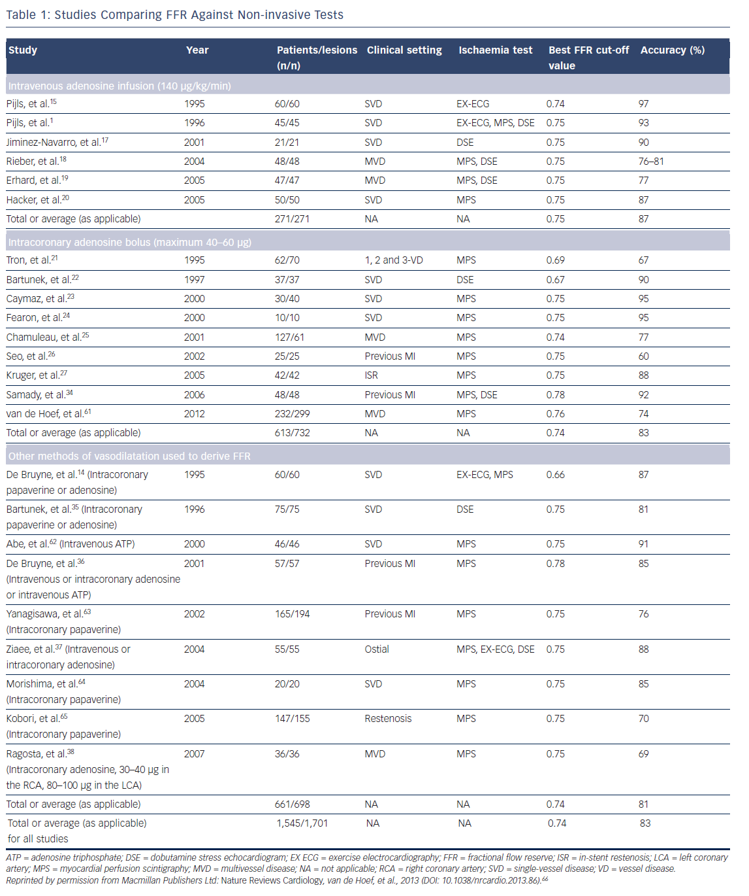
Mohdnazri SR, Keeble TR, Sharp AS
Table 1: Studies Comparing FFR Against Non-invasive Tests
Citation: Interventional Cardiology Review 2016;11(1):17–26
https://doi.org/10.15420/icr.2016:7:2

