Slide 1
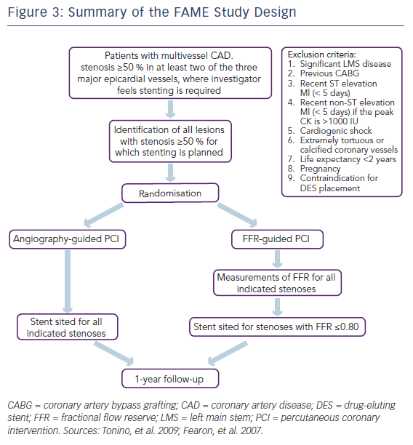
Mohdnazri SR, Keeble TR, Sharp AS
Figure 3: Summary of the FAME Study Design
Citation: Interventional Cardiology Review 2016;11(1):17–26
https://doi.org/10.15420/icr.2016:7:2

