Slide 1
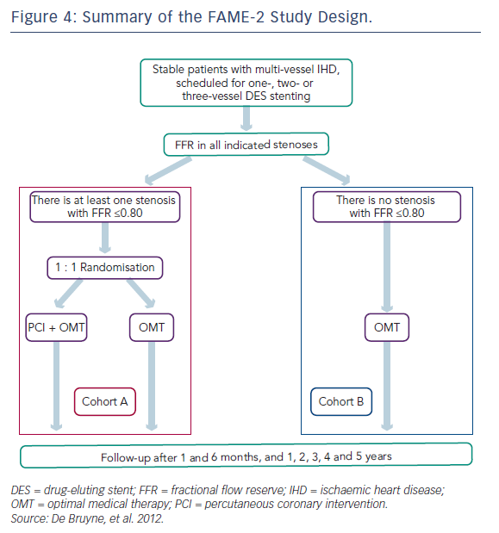
Mohdnazri SR, Keeble TR, Sharp AS
Figure 4: Summary of the FAME-2 Study Design
Citation: Interventional Cardiology Review 2016;11(1):17–26
https://doi.org/10.15420/icr.2016:7:2

