Slide 1
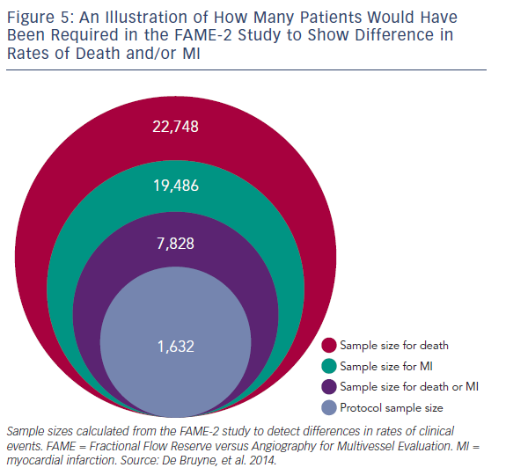
Mohdnazri SR, Keeble TR, Sharp AS
Figure 5: An Illustration of How Many Patients Would Have Been Required in the FAME-2 Study to Show Difference in Rates of Death and/or MI
Citation: Interventional Cardiology Review 2016;11(1):17–26
https://doi.org/10.15420/icr.2016:7:2

