Slide 1

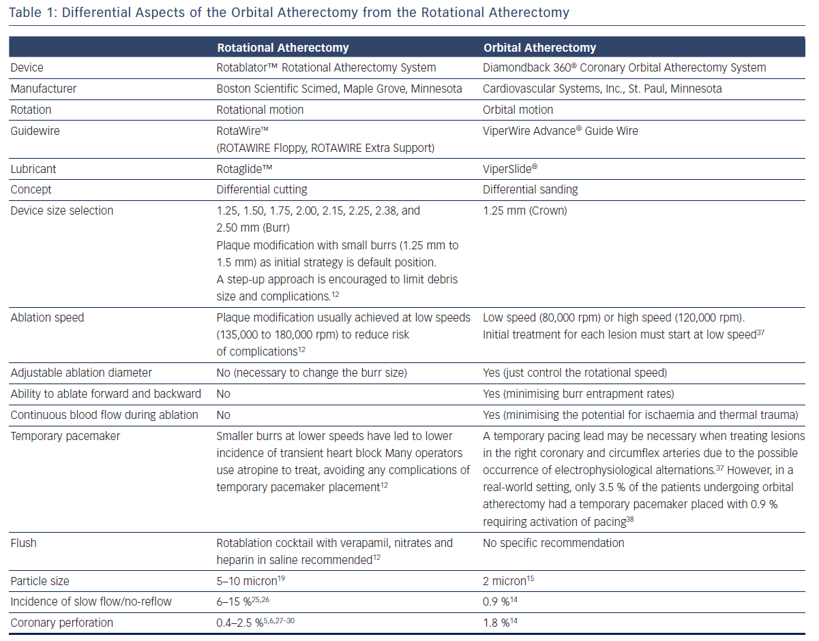
Sotomi Y, Shlofmitz RA, Colombo A, Serruys PW, Onuma Y
Differential Aspects of the Orbital Atherectomy from the Rotational Atherectomy
Citation: Interventional Cardiology Review 2016;11(1):33–8
https://doi.org/10.15420/icr.2015:19:2

