Slide 1
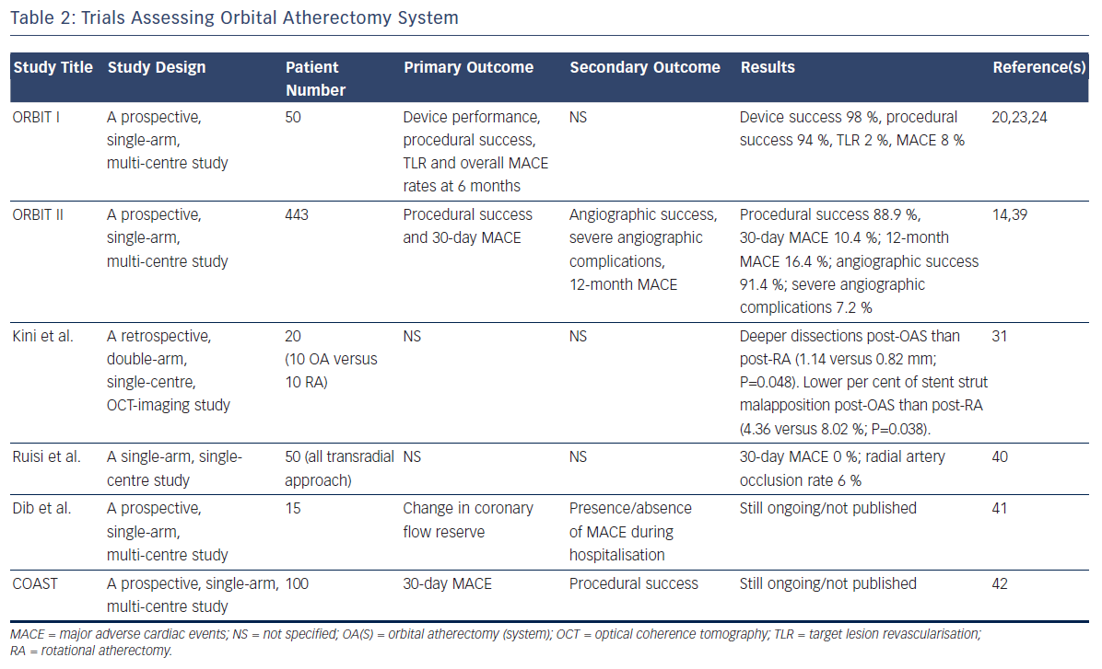
Sotomi Y, Shlofmitz RA, Colombo A, Serruys PW, Onuma Y
Trials Assessing Orbital Atherectomy System
Citation: Interventional Cardiology Review 2016;11(1):33–8
https://doi.org/10.15420/icr.2015:19:2

