Slide 1
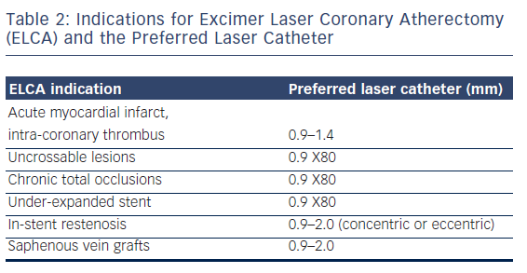
Rawlins J, Din J, Talwar S, O’Kane P
Table 2: Indications for Excimer Laser Coronary Atherectomy (ELCA) and the Preferred Laser Catheter
Citation: Interventional Cardiology Review 2016;11(1):27–32
https://doi.org/10.15420/icr.2016:2:2

