Slide 1
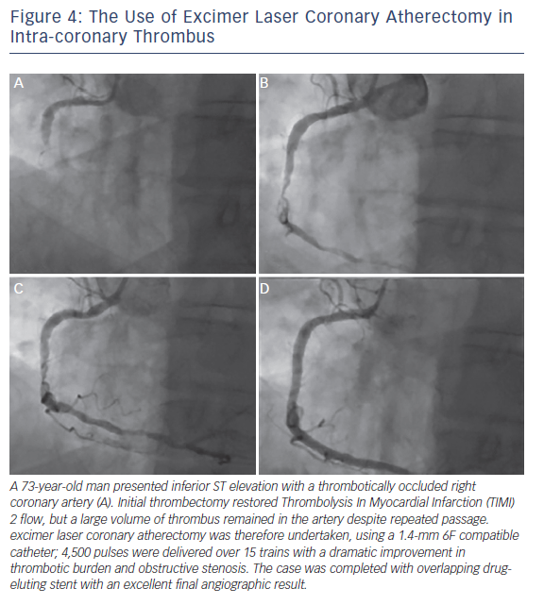
Rawlins J, Din J, Talwar S, O’Kane P
Figure 4: The Use of Excimer Laser Coronary Atherectomy in Intra-coronary Thrombus
Citation: Interventional Cardiology Review 2016;11(1):27–32
https://doi.org/10.15420/icr.2016:2:2

