Slide 1
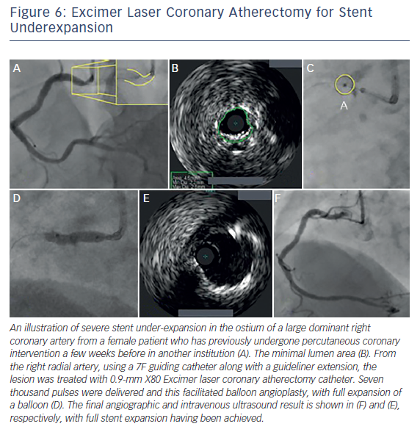
Rawlins J, Din J, Talwar S, O’Kane P
Figure 6: Excimer Laser Coronary Atherectomy for Stent Underexpansion
Citation: Interventional Cardiology Review 2016;11(1):27–32
https://doi.org/10.15420/icr.2016:2:2

