Slide 1
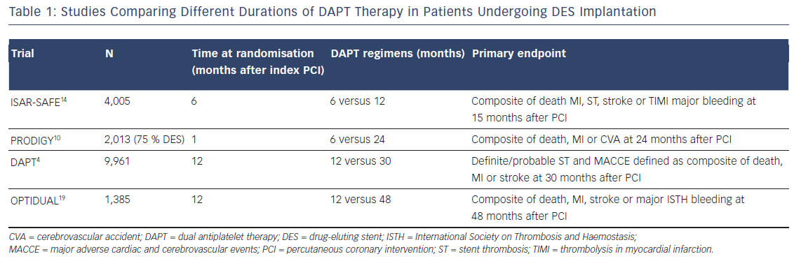
Magnani G, Valgimigli M
Table 1: Studies Comparing Different Durations of DAPT Therapy in Patients Undergoing DES Implantation
Citation: Interventional Cardiology Review 2016;11(1):51–3
https://doi.org/10.15420/icr.2015:17:2

