Slide 1

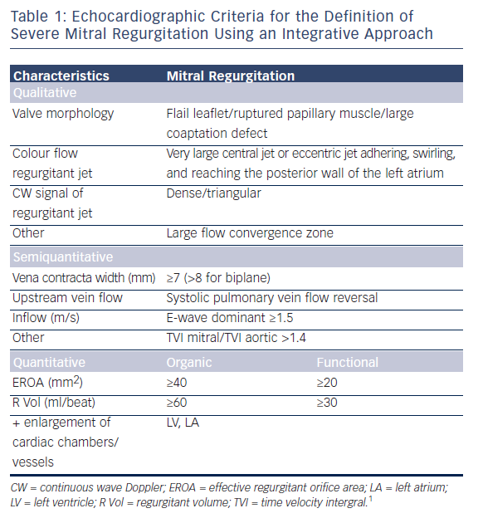
O'Sullivan CJ, Tüller D, Zbinden R, Eberli FR
Table 1: Echocardiographic Criteria for the Definition of Severe Mitral Regurgitation Using an Integrative Approach
Citation: Interventional Cardiology Review 2016;11(1):54–8
https://doi.org/10.15420/icr.2016:11:1

