Slide 1
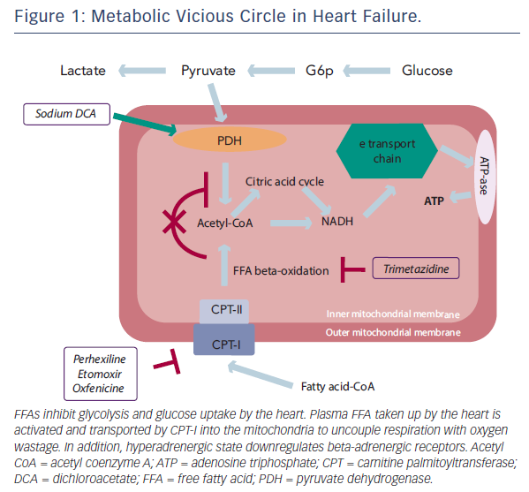
Fragasso G
Metabolic Vicious Circle in Heart Failure
Citation: Cardiac Failure Review 2016;2(1):8–13
https://doi.org/10.15420/cfr.2016:5:2

